Slide 1
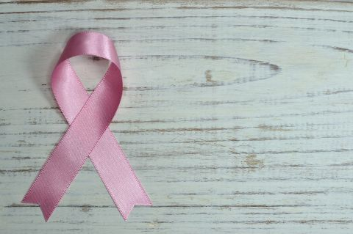





Data+ 2018:
Project #6 Women’s Spaces
Project Lead: Dr. Charlotte Sussman
Project Manager: Michelle Sroka
Undergraduates: Alexis Malone, Sandra Luksic & Nathan Liang

Slide 2

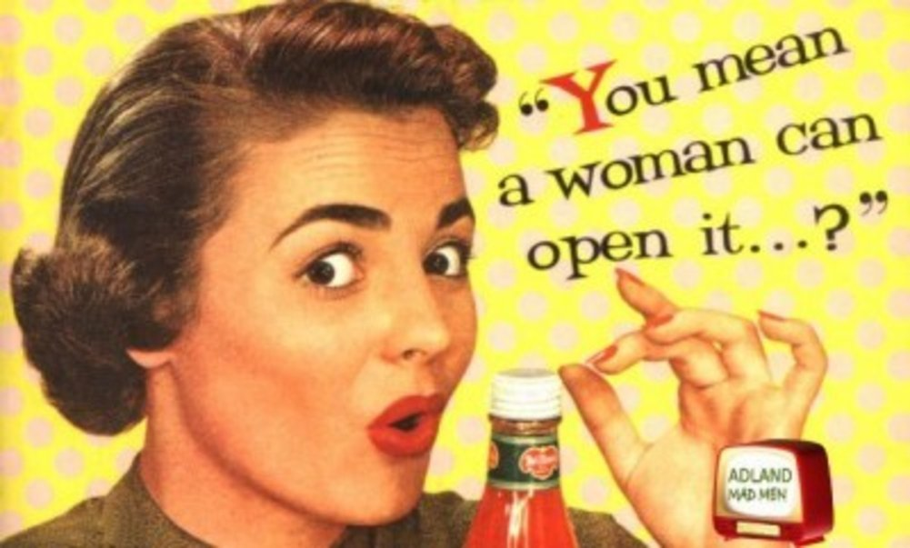

A “women’s space” = stereotypes of women
Women’s place and role in society
How society defines and maintains what women should belong/what they should do
Can be obvious (exclusion from universities) or subtle (perceptions)
Society enforces certain roles of women and perpetuates stereotypes
Notes:
Eating disorders, racism, objectification, sexual harassment, sexualization, wealth gap, gender wage gap,

Slide 3
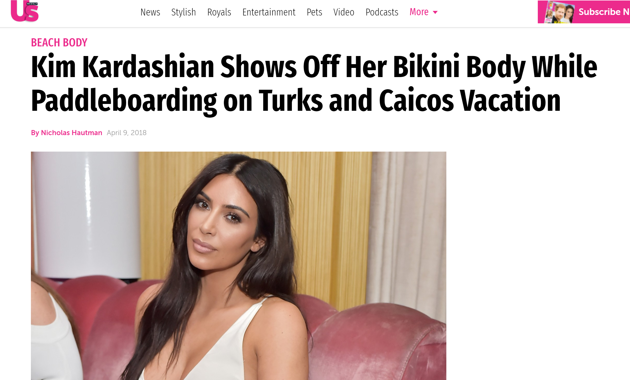
Media Sets Standards for Women
Sets the topic for public discussion (e.g., #MeToo)
Sets standards
Beauty, sex, work, home life, mental standards
Representation
Who exists and where
Information source
Credibility

Slide 4
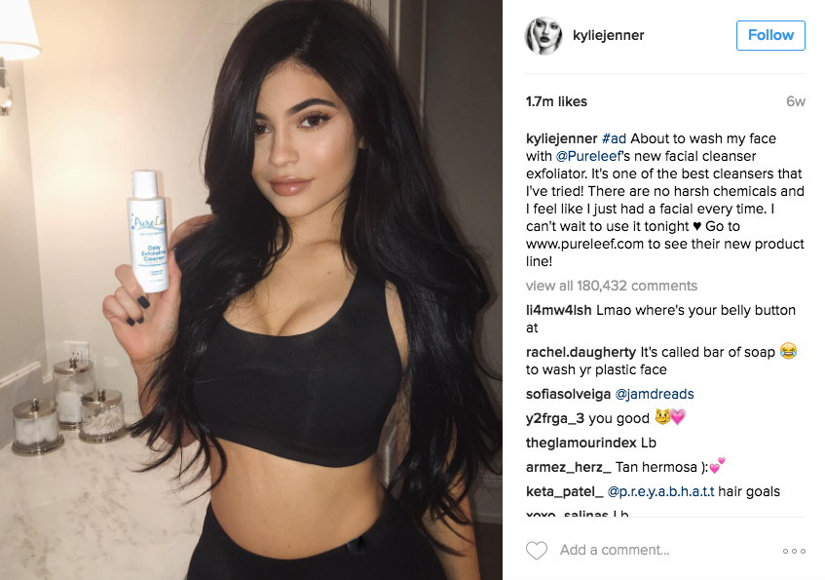
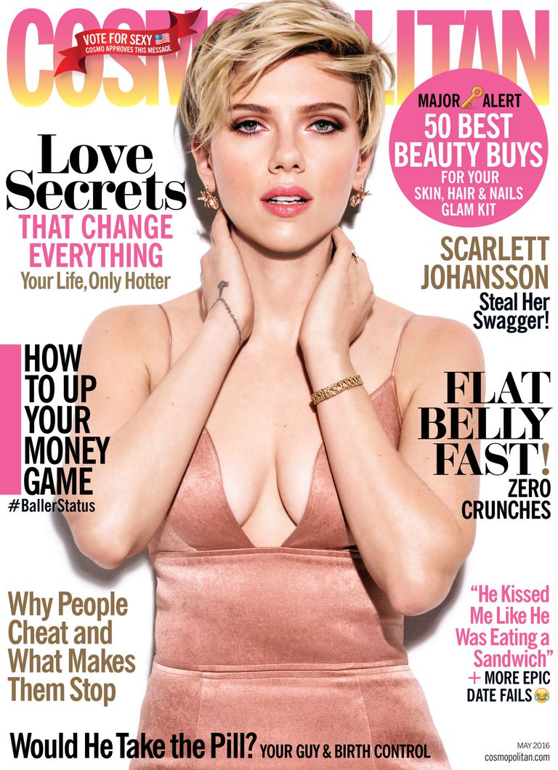
Stereotypes in Mass Media/Pop Culture
Notes:
Eating disorders, racism, objectification, sexual harassment, sexualization, wealth gap, gender wage gap,
One way society perpetuates stereotypes is through mass media targeted at women, like women’s magazines and social media
Sends women messages about how to look, act, dress, buy

Slide 5
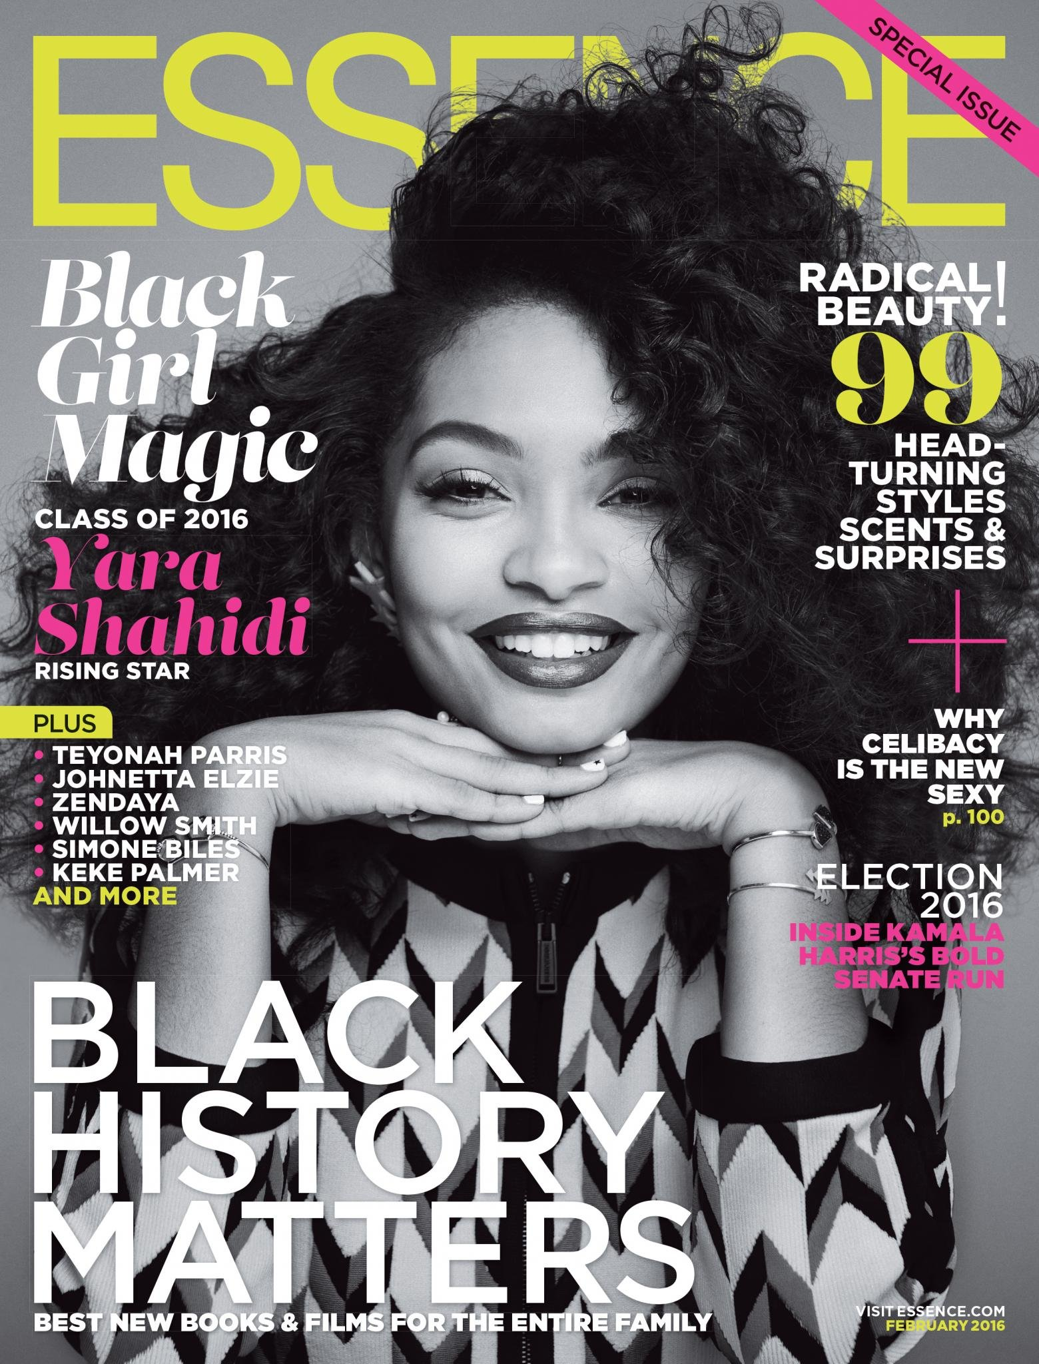
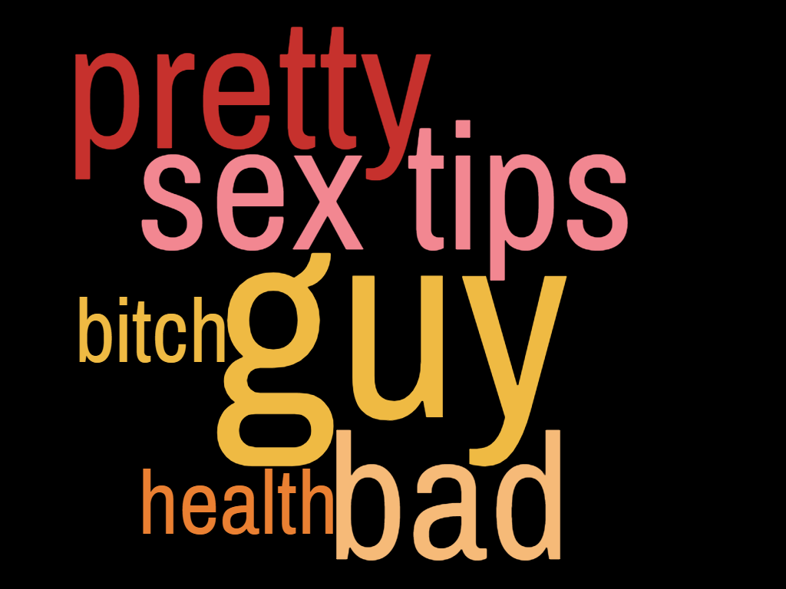


Overview of Project

Slide 6
Research Questions
How do the aesthetics and semantics of online and print media reinforce or undermine stereotypes about women?
Aesthetics = images, color frequencies, skin tone, fashion
Semantics = words, messages, text
How do these messages change over time or between magazines?
Why is media and social media motivated to reinforce or undermine stereotypes of women?

Slide 7
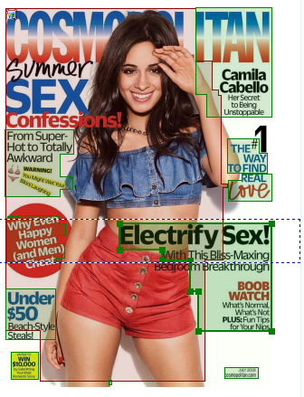
Text and Image Analysis Tools
Web Scraping
OCR Software: ABBYY FineReader
Text Mining®
RGB/HSL Color Analysis
Facial and Image Recognition Software
Notes:
HSL = hue saturation lightness

Slide 8
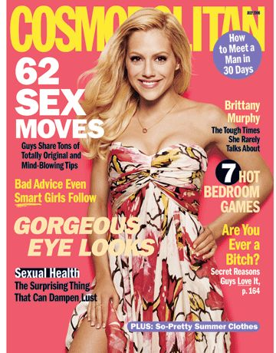
Magazine Textual Analysis:
Cosmopolitan, July 2006

Slide 9
Text Analysis
Words
Sex (2)
Guy (3)
Pretty (2)
Bad (2)
Bitch/Slur (1)
Sexual Health (1)
Sex Appeal (1)
Possible Relationships
“Sexual Health” and “Sex Appeal” appear in same message
Girl and bad appear together twice
Guy’s needs appear twice

Slide 10
Image Analysis
Facial and Body Standard
Color Scheme
Fashion
July 2006, Cosmopolitan

Slide 11
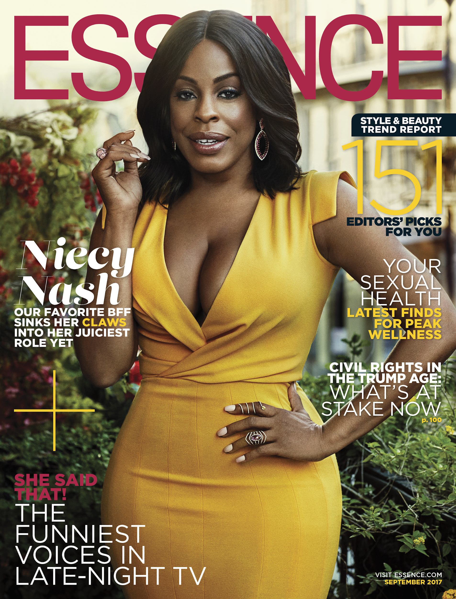

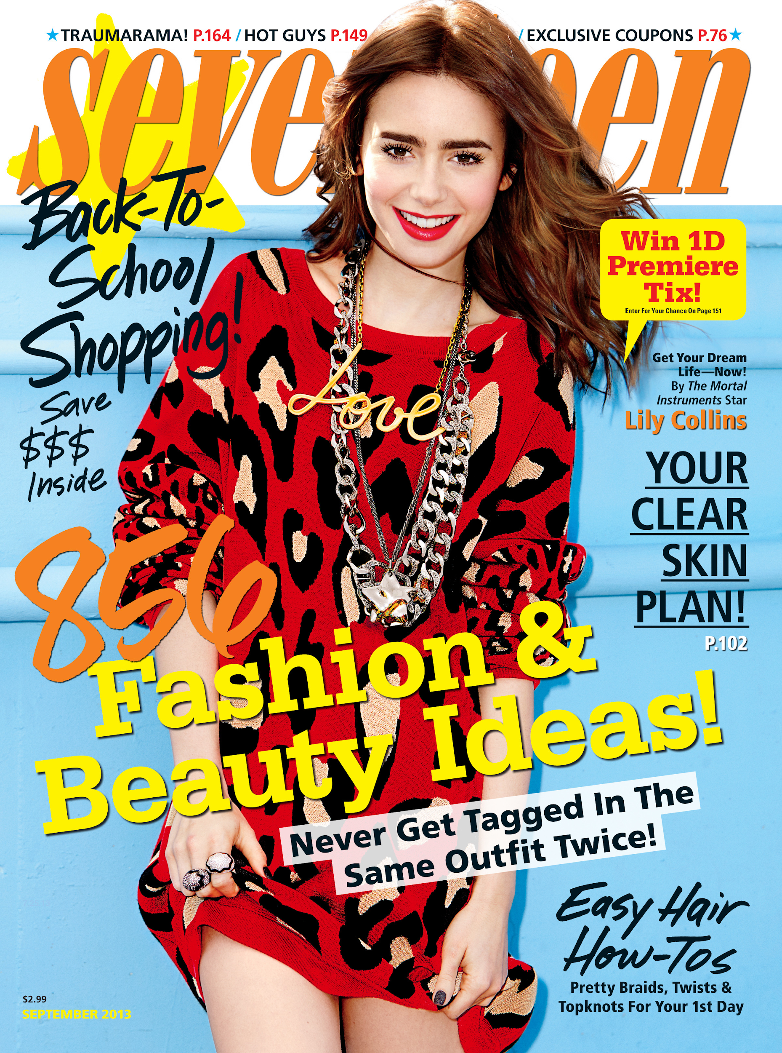
Further Analysis
How do patterns of text and images vary between different magazines and over time?

Slide 12
Limitations
Qualitative data
Subjectivity
Low resolution images
Considerations
Control with Men’s and Gender Neutral Magazines
Restricted to Western standards (WEIRD - Western, Educated, Industrialized, Rich, Democratic)

Slide 13
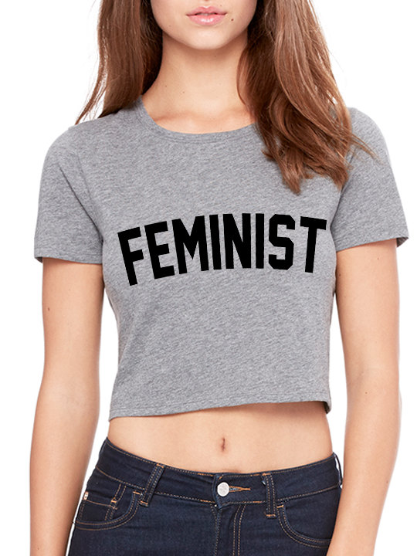
Goals/Possible Outcomes
Body of data on topics and images of women’s magazines
Bechdel-esque test for magazine covers
Intersectionality and non-binaries
Comparison with physical women’s spaces
Feminist data science

Slide 14
Questions?
Special Thanks To:
John Little Eric Monson Mark Thomas Drew Keener
Liz Milewicz
Will Shaw
Kelly Wooten
Dr. David Siegel
Dr. Mine Cetinkaya-Rundel

